Slide 1
CEF 440: INTERNET PROGRAMMING (J2EE) AND MOBILE PROGRAMMING
FINAL PRESENTATION
Course Instructor
DR. VALERY NKEMENI

Slide 2
Table of contents
01
02
03
04
IMPLEMENTATION
RESULTS
LITERATURE REVIEW
ANALYSIS & DESIGN
05
CONCLUSION

Slide 3
Introduction
CARRYAMGO is here to facilitate and ensure a seamless interaction between buyers and sellers in a market setting, enabling buyers to access information about item availability, prices, and locations, while empowering sellers to showcase their products, prices, and market locations

Slide 4
01
LITERATURE REVIEW

Slide 5
CARRYAMGO
Mobile apps have become an essential tool for many businesses and consumers in various domains, such as e-commerce, education, health care, entertainment, and more. Mobile apps can provide various benefits, such as convenience, accessibility, personalization, interactivity, and engagement. One of the domains that can benefit from mobile apps is the market management system, which is a system that connects buyers and sellers in a physical market place.

Slide 6
General Concepts on mobile apps for a market management system.
A mobile app for a market management system is a software application that runs on a mobile device, such as a smartphone or a tablet, and allows users to access and manage information related to a physical marketplace.
For buyers
The app can allow buyers to search for products or services by keywords, categories, prices, ratings, reviews, availability, location and others.
For sellers
The app can allow sellers to create and manage their profiles or stores on the app platform, where they can display t
Related Works
Several studies have been conducted on developing and evaluating mobile apps for a market management system in different contexts and scenarios

Slide 7
02
ANALYSIS AND DESIGN

Slide 8
CARRYAMGO
We carried out analysis and design for our market management system that could better link various buyers and sellers found in our local markets, by making buyers know the best goods available for them in the market while on the other hand helping sellers increase their revenue as they have exposure to more customers

Slide 9
ANALYSIS
Upon analyses of a market management system, a couple of perspectives were looked into so as develop a system that meets users’ needs.
Product perspective
This system is meant to serve as a platform where the display and review of goods alongside their prices and locations can be carried out conveniently.
System Interface
System Interface means an electronic exchange of data between two or more systems to allow an efficient flow of information.
User Interface
This system shall provide a very intuitive and simple interface to the buyers and sellers so that the buyers can efficiently review goods and be aware of their availability, prices, and location before visiting the market.
Hardware interface
Server and client side

Slide 10
Proposed Methodologies
A couple of methodologies were come across while analyzing the system and basically 3 main methodologies were being used in building a system that could better link buyers and sellers with respect to the phase of development process. The methodologies used were agile methodology, the requirement analysis methodology and the UML language methodology

Slide 11
Design
This phase in the development focused on a couple of aspects which helped in building the system. These aspects were the system requirements, the system architecture and the user interface design

Slide 12
DESIGN
System Requirements
This subsection details out what exactly the functional and non-functional requirements were for a mobile app that manages a market system
System Architecture
In this section, the UML methodology was applied and a couple of UML diagrams were drawn
User interface design
The UI/UX design of the mobile application was carefully crafted to ensure a user-friendly and visually appealing experience for both buyers and sellers. The design focused on providing intuitive navigation, clear presentation of information, and seamless interactions. This section delves into the specifics of the UI/UX design, highlighting key features, interface components, and the overall user journey within the application.

Slide 13
03
IMPLEMENTATION

Slide 14
CARRYAMGO
The implementation was done in two main phases which are the Frontend and the Backend.
Tools and Materials used
ReactNative for the frontend
Django for the backend
PostgreSQL for the database
Postman and TunderClient for testing API
Render for deploying the backend

Slide 15
FRONTEND IMPLEMENTATION
We implemented the frontend with react native and below are some of the react components used
TouchableOpacity: Used instead of button so it can be styled.
View: Container view acts like a div
Text: To display text to users
TextInput: Enables users type in input using the default keyboard it provides
Switch: Enables users accept or decline our policies at sign up page
ScrollView: Used to enable scrolling on a page
Stylesheet: Enables styling of components.
Stack Navigation
Bottom Tab Navigation
Modal Navigation

Slide 16
BASIC ELEMENT OF THE SYSTEM
Due to the modular nature of the system, we have the card as the basic element of the system.
Card: This component was created to display various products available in the market. It renders data from the API. When the API is fetched, the data is rendered and displayed in the cards through the props.
The cards contain the following:
Picture of available food
Food name, price
Amount of that item available
Shop name
Market name
Shade number
The order button.

Slide 17
BACKEND IMPLEMENTATION
The backend was developed using Django, a powerful Python web framework, to provide a robust and scalable solution for the application. This report will cover various aspects of the implementation, including the architecture, features, database management, API endpoints, testing, and deployment.

Slide 18
ARCHITECTURE OVERVIEW
The backend architecture of the Carryamgo mobile application follows a client-server model. It consists of a Django web server that handles incoming requests from the frontend and interacts with the database to process and retrieve data. The backend is responsible for user authentication, managing buyer and seller accounts, handling product orders, notifications, messaging, promotions, and database operations.

Slide 19
MODELS
Models: We implemented several models to handle the data that will collected on our mobile app. This model also helps us to create our database tables they include:
User model
Seller model
Buyer model
Product model
Subscription model
Notification model
Message model
Rating model
Order model
Shop model
Promotion model

Slide 20
API ENDPOINTS
We created api endpoints that allowed our application to make use of our models in the form of apis. They are listed below:
User login and authentication api
Product api
Order api
Seller api
Buyer api
Subscription api
Notification api

Slide 21
04
RESULTS

Slide 22
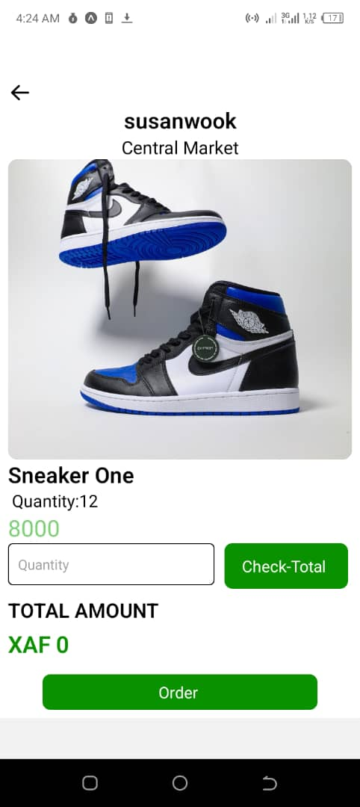
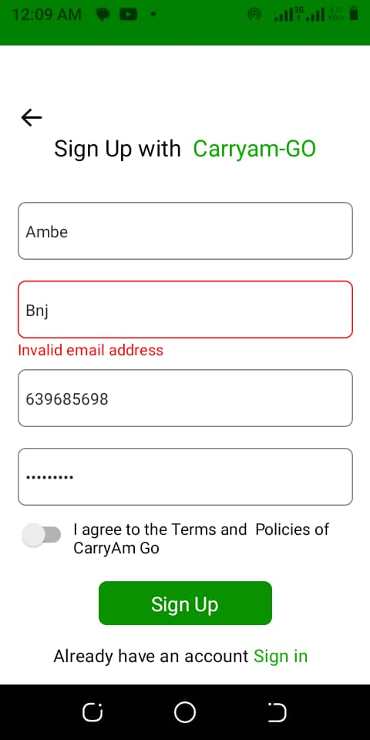
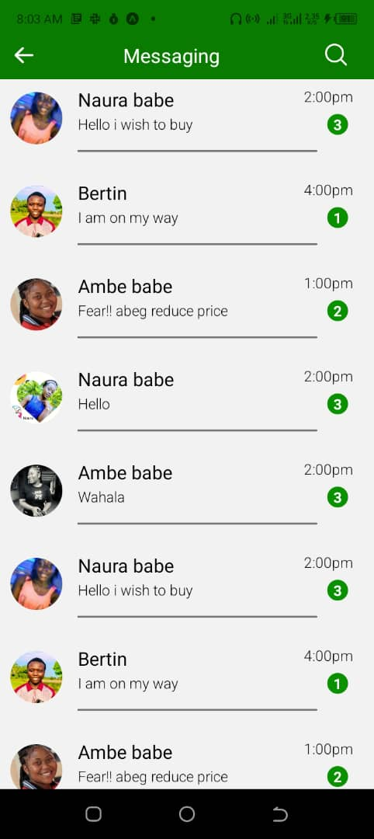

Slide 23
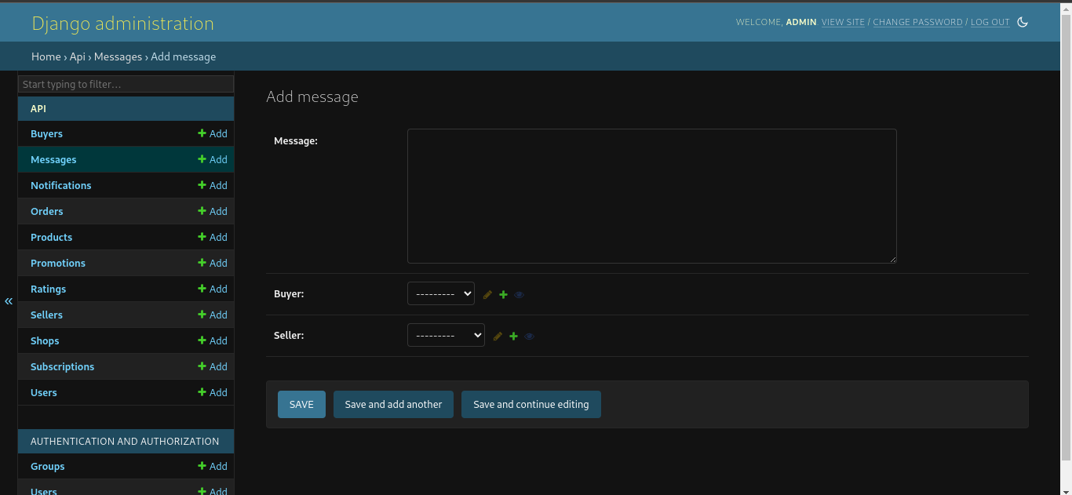
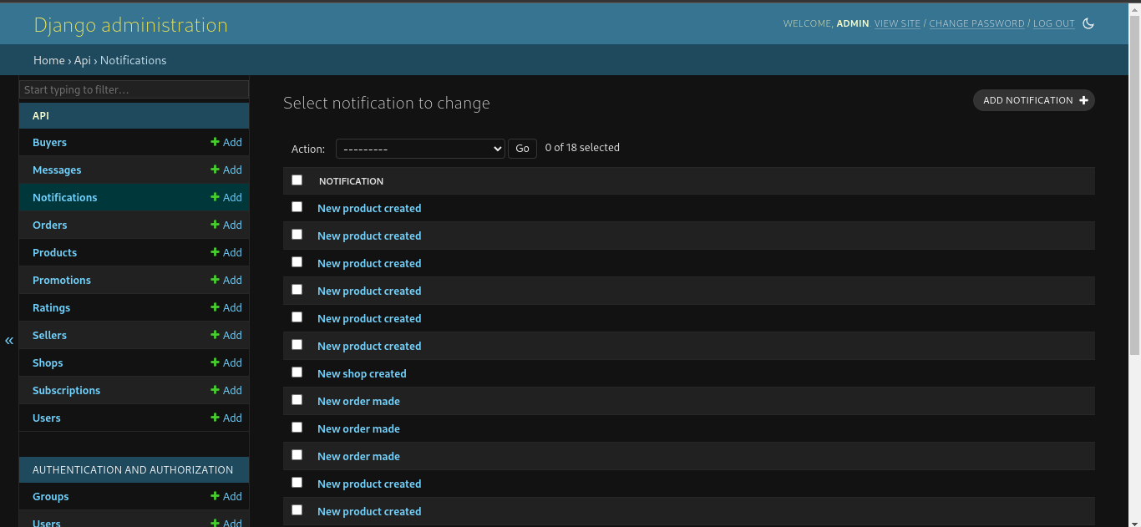

Slide 24
05
CONCLUSIONS

Slide 25
After the analyses, design and implementation of a market management system, a couple of findings were got which can be seen below
The market management system effectively addresses the identified needs and requirements of the market, providing a comprehensive solution for managing the buying and selling process.
The system's design and features support effective buyer-seller interactions, increase sales, and reduce costs, leading to improved efficiency and profitability for market participants.
The global architecture of the solution ensures that the system operates effectively and efficiently across different regions and locations, while maintaining scalability, flexibility, and reliability.

